Slide 1

Welcome
To
All teachers and students of AGS
Topic:
How to add table in html
Presented by:
Sana Sattar
Presented to:
Sir AD Malik Sahib
So lets go

Slide 2
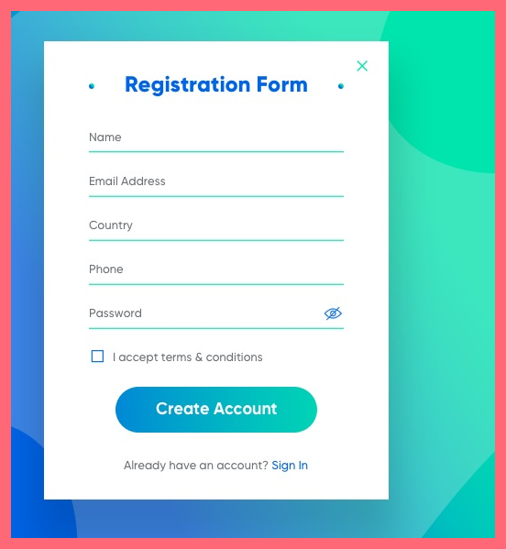
Form:-
An HTML form is used to collect user input. The user input is most often sent to a server for processing.

Slide 3
The <from> element:-
. form elements .
The HTML element is used to create an HTML form for user input: <form> element</form>

Slide 4
different types of input elements:-
text fields,
checkboxes,
radio buttons,
submit buttons, etc

Slide 5
The HTML<input> element is the most used form element:-
An element can be displayed in many ways, depending on the type attribute.
Here are some examples:
Type Description <input type=“text”> Displays a single-line text input field .
<input type=“radio”> Displays a radio button (for selecting
one of many choices)
<input type=“checkbox”> Displays a checkbox (for selecting zero or more of many choices)
<input type=“submit”> Displays a submit button (for submitting the form)

Slide 6
the name attribute for <input>:-
Example This example will not submit the value of the "First name" input field: First name: Checkboxe
Example This example will not submit the value of the "First name" input field: First name: Checkboxe
Notice that each input field must have a name attribute to be submitted. If the name attribute is omitted, the value of the input field will not be sent at all.

Slide 7
Checkbox:-
The defines a checkbox. Checkboxes let a user select ZERO or MORE options of a limited number of choices.

Slide 8
Radio:-
Define:
The defines a radio button. Radio buttons let a user select ONE of a limited number of choices.

Slide 9
Text fields:-
The <input type=“text”> defines a single-line input field for text input.

Slide 10
Html form example:-
<html>
<head>
<tittle>form</tittle>
</head>
<body>
<h2>Registration form</h2>
<form>
<fieldset>
<lagend>user personal information</lagend>
<label>Enter your full name</label><br>
<input type=“text” name=“name” placeholder=“Enter your full namr”><br>

Slide 11
<label>Enter your email</label><br>
<input type=“email” name=“email” placeholder=“Enter your email”><br>
<label>Enter your password</label><br>
<input type=“password” name=“pass” placeholder=“Password><br>
<label>Enter confirm password</label><br>
<input type=“password” name=“pass” placeholder=“confirm password”><br>
<br><label>Enter your Gender</label><br>
<input type=“radio” id=“gender” name=“gender” value=“male”><br>
<input type=“radio” id=“gender” name=“gender” value=“female”><br>
<input type=“radio” id=“gender” name=“gender” value=“others”><br>
<br>Enter your address:<br>
<textarea></textarea><br>

Slide 12
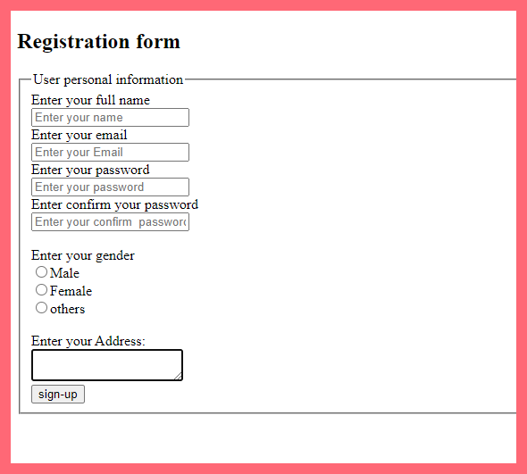
<input type=“submit” value=“sign up”>
</fieldset> output:-
</form>
</body>
</html>

Slide 13

Thanks to:-
Sir Allah Ditta

